Slide 1
Insurance claim fraud detection
Anirudh.m.v

Slide 2
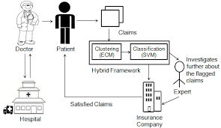
history
Insurance fraud is any act committed to defraud an insurance process. It occurs when a claimant attempts to obtain some benefit or advantage they are not entitled to, or when an insurer knowingly denies some benefit that is due.
Insurance fraud has existed since the beginning of insurance as a commercial enterprise.
Insurance fraud are diverse and occur in all areas of insurance. Insurance crimes also range in severity, from slightly exaggerating claims to deliberately causing accidents or damage.

Slide 3
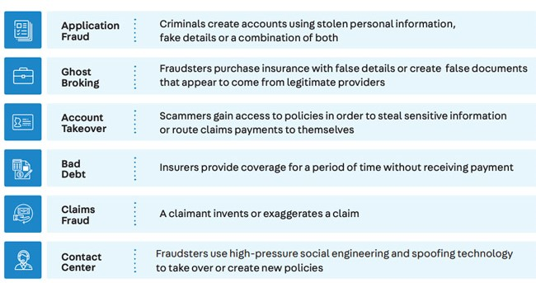
Problems faced

Slide 4
Business objective
Insurance Claim Detector is used by the insurance company to decide whether the claimed insurance is Fraud or Genuine. It is an insurance company which provides insurance to Hospitals, depending upon those hospital's details. This model can be used in such a way that by entering hospital details the model will predict whether that particular hospital which claimed for insurance is Fraud or Genuine.

Slide 5
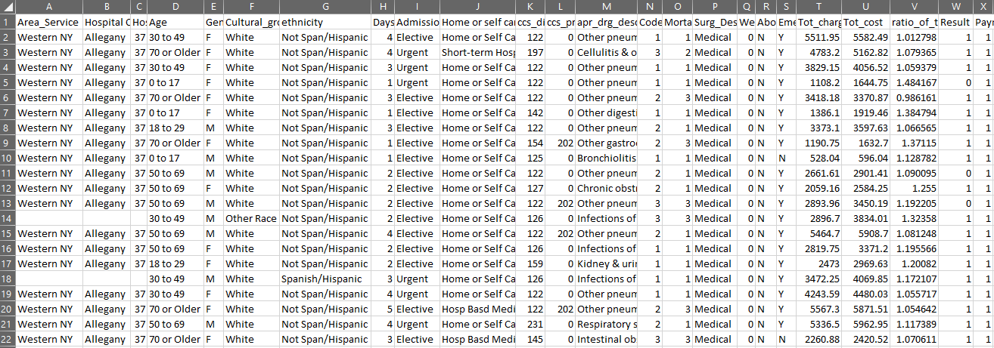
Dataset details
Total number of records : 1048575
Total number of features : 24

Slide 6
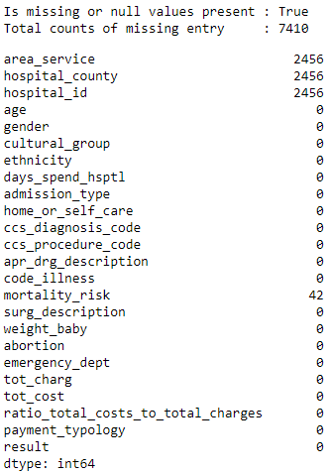
DATA PREPROCESSING
a) Is missing or any null values in our dataset ?
True
b) How many is total counts of the missing entries?
7410
c) In which feature, we have majority of the missing values?
area_service
hospital_id
hospital_county

Slide 7
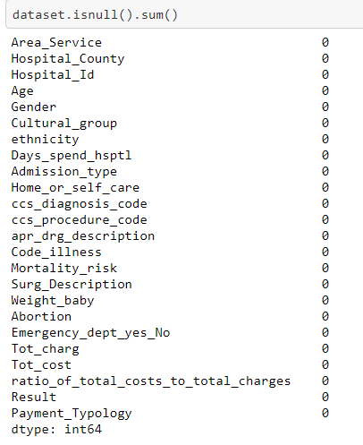
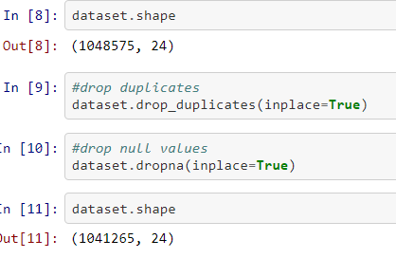
Handling duplicates

Slide 8
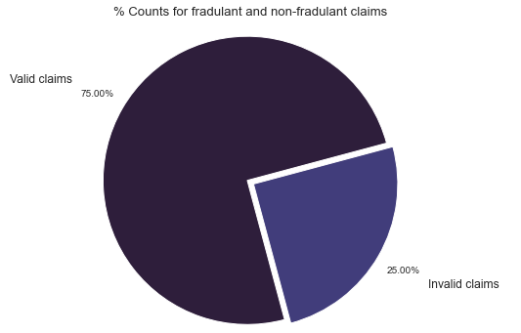
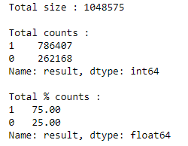
Data visualization
Target variable have highly imbalance proportion of valid to fraud claims
Ratio of valid claims to fraud claims is about 75:25

Slide 9
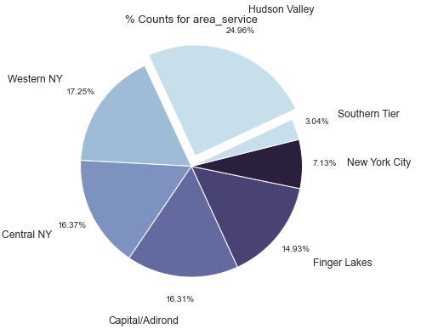
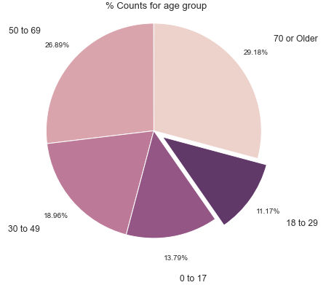
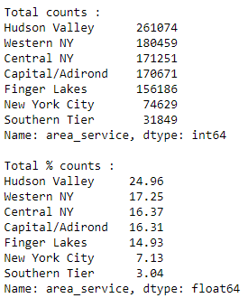
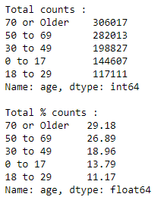
1) area_service
2) age

Slide 10
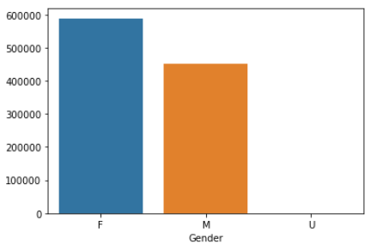
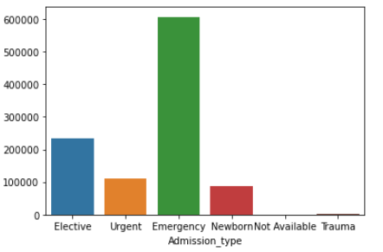
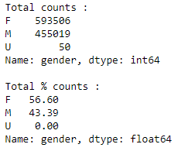
Bar plot
As the plot represents that the admission type with Emergency situation are high.

Slide 11
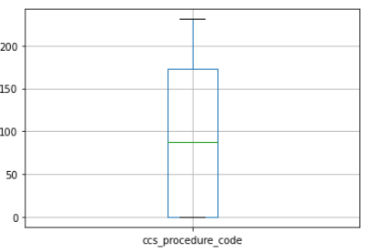
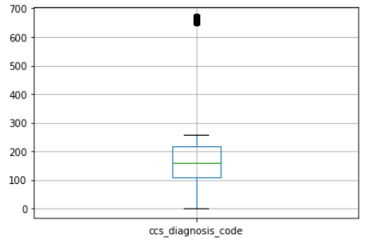
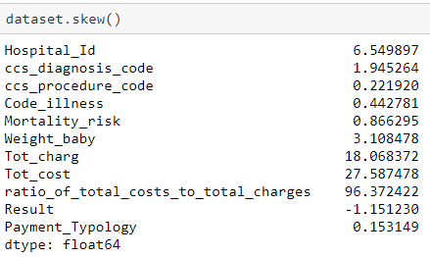
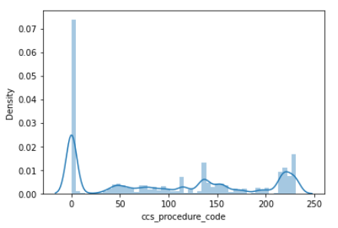
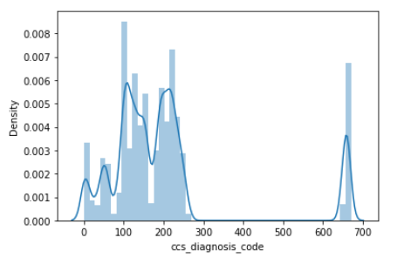
OUTLIER DETECTION

Slide 12
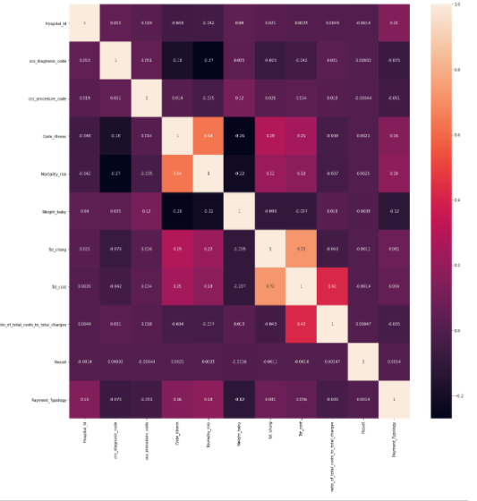
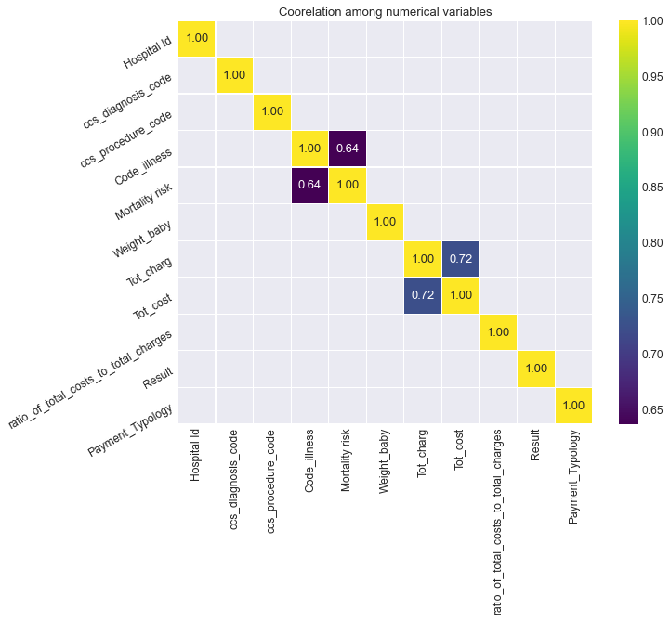
CORRELATION OF THE DATASET

Slide 13
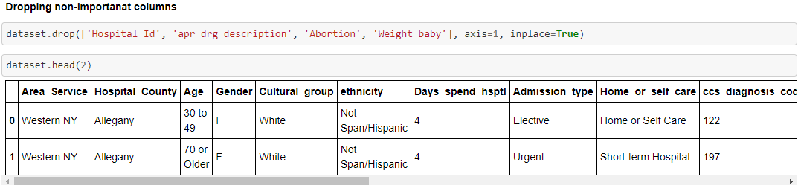
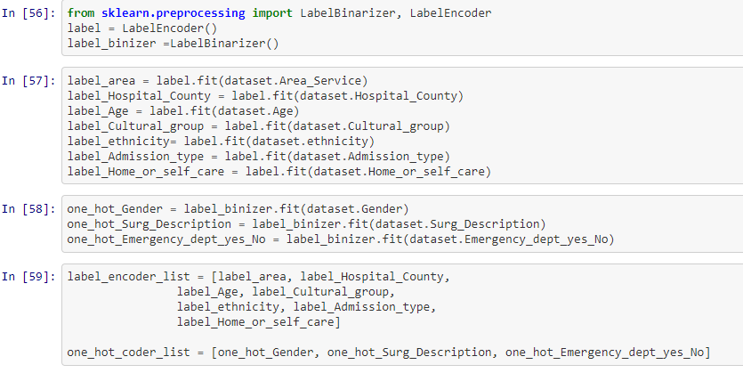

Slide 14
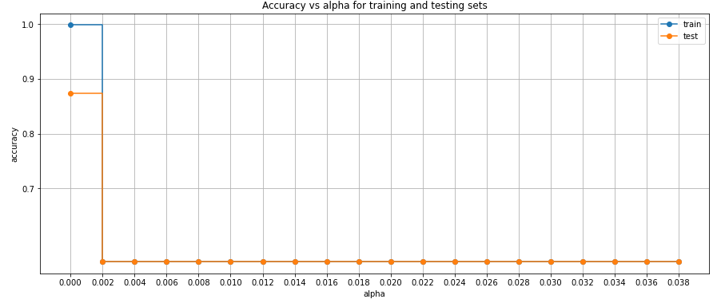
Upsampling before splitting the data into train & test

Slide 15
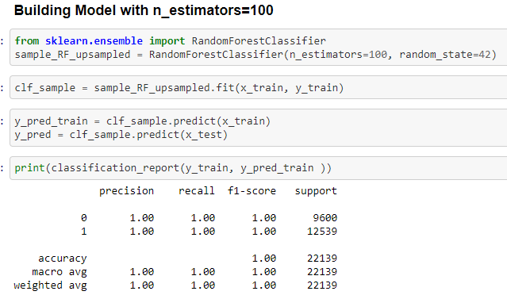
MODEL BUILDING

Slide 16
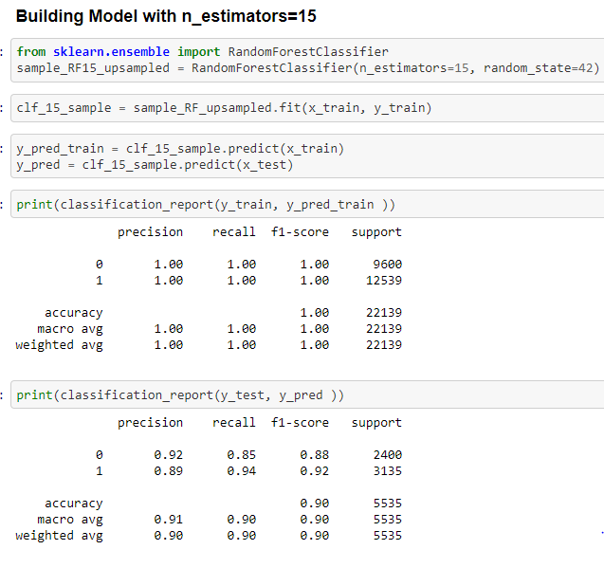

Slide 17
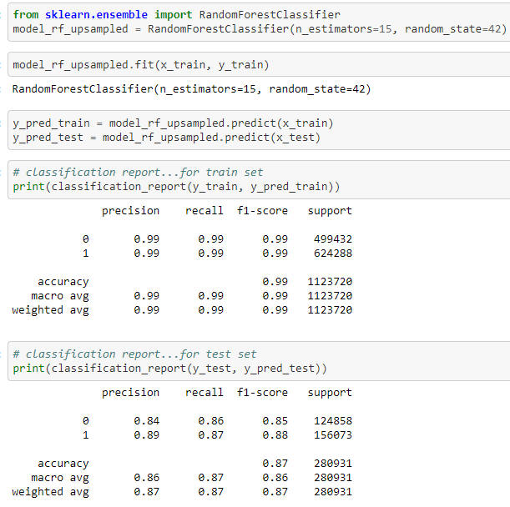
MODEL BUILDING FOR WHOLE DATASET

Slide 18
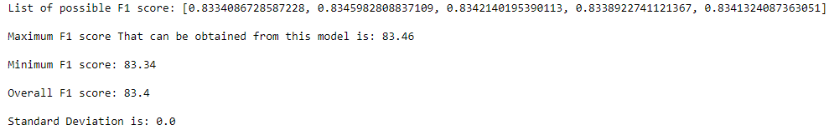
FINAL SCORES

Slide 19
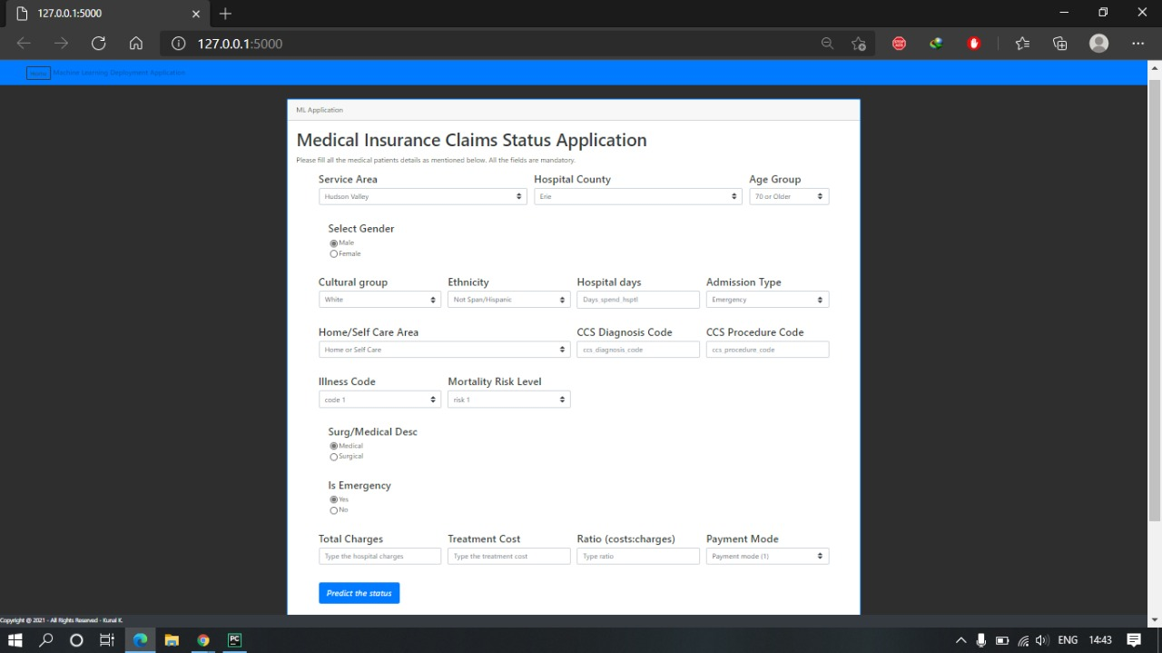
MODEL DEPLOYMENT
( FLASK, Streamlit )

Slide 20


